Slide 1


Project Update
Jan 31st, 2024
The Second vLLM Meetup @ IBM

Slide 2
Topics
vLLM Overview (@zhuohan123)
Project Update (@WoosukKwon)
Development Roadmap (@simon-mo & @LiuXiaoxuanPKU)

Slide 3
Topics
vLLM Overview
Project Update
Development Roadmap

Slide 4


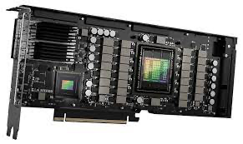
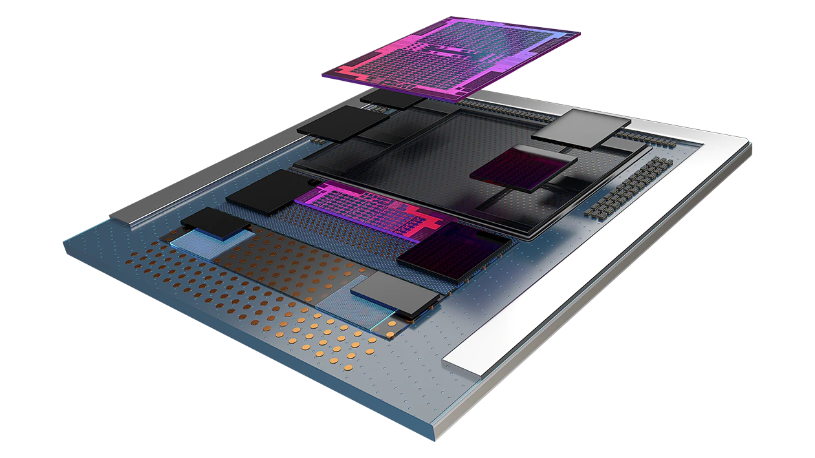
The era of Large Language Models (LLMs)
LLM
Chatting
Programming
BizOps
Content creation
Dev tools
Served by GPUs

Slide 5
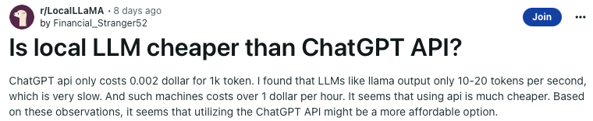


Serving LLMs is (surprisingly) slow and expensive
A single A100 GPU can only serve < 1 request per second
Moderate size of model (13B parameters) and input
A ton of GPUs are required for production-scale LLM services

Slide 6
Our Goal
Build the fastest and
easiest-to-use open-source
LLM inference & serving engine

Slide 7
PagedAttention
An attention algorithm that allows for storing continuous keys and values in non-contiguous memory space.

Slide 8
Manage KV cache like OS virtual memory
Physical KV blocks
Block Table
computer | scientist | and | mathe- matician
Artificial | Intelli- gence | is | the
renowned
future | of | tech- nology
Alan | Turing | is | a
Block Table
Request
A
Request
B
Logical KV blocks
Logical KV blocks
Alan | Turing | is | a
computer | scientist | and | mathematician
renowned
Artificial | Intelli- gence | is | the
future | of | tech- nology

Slide 9



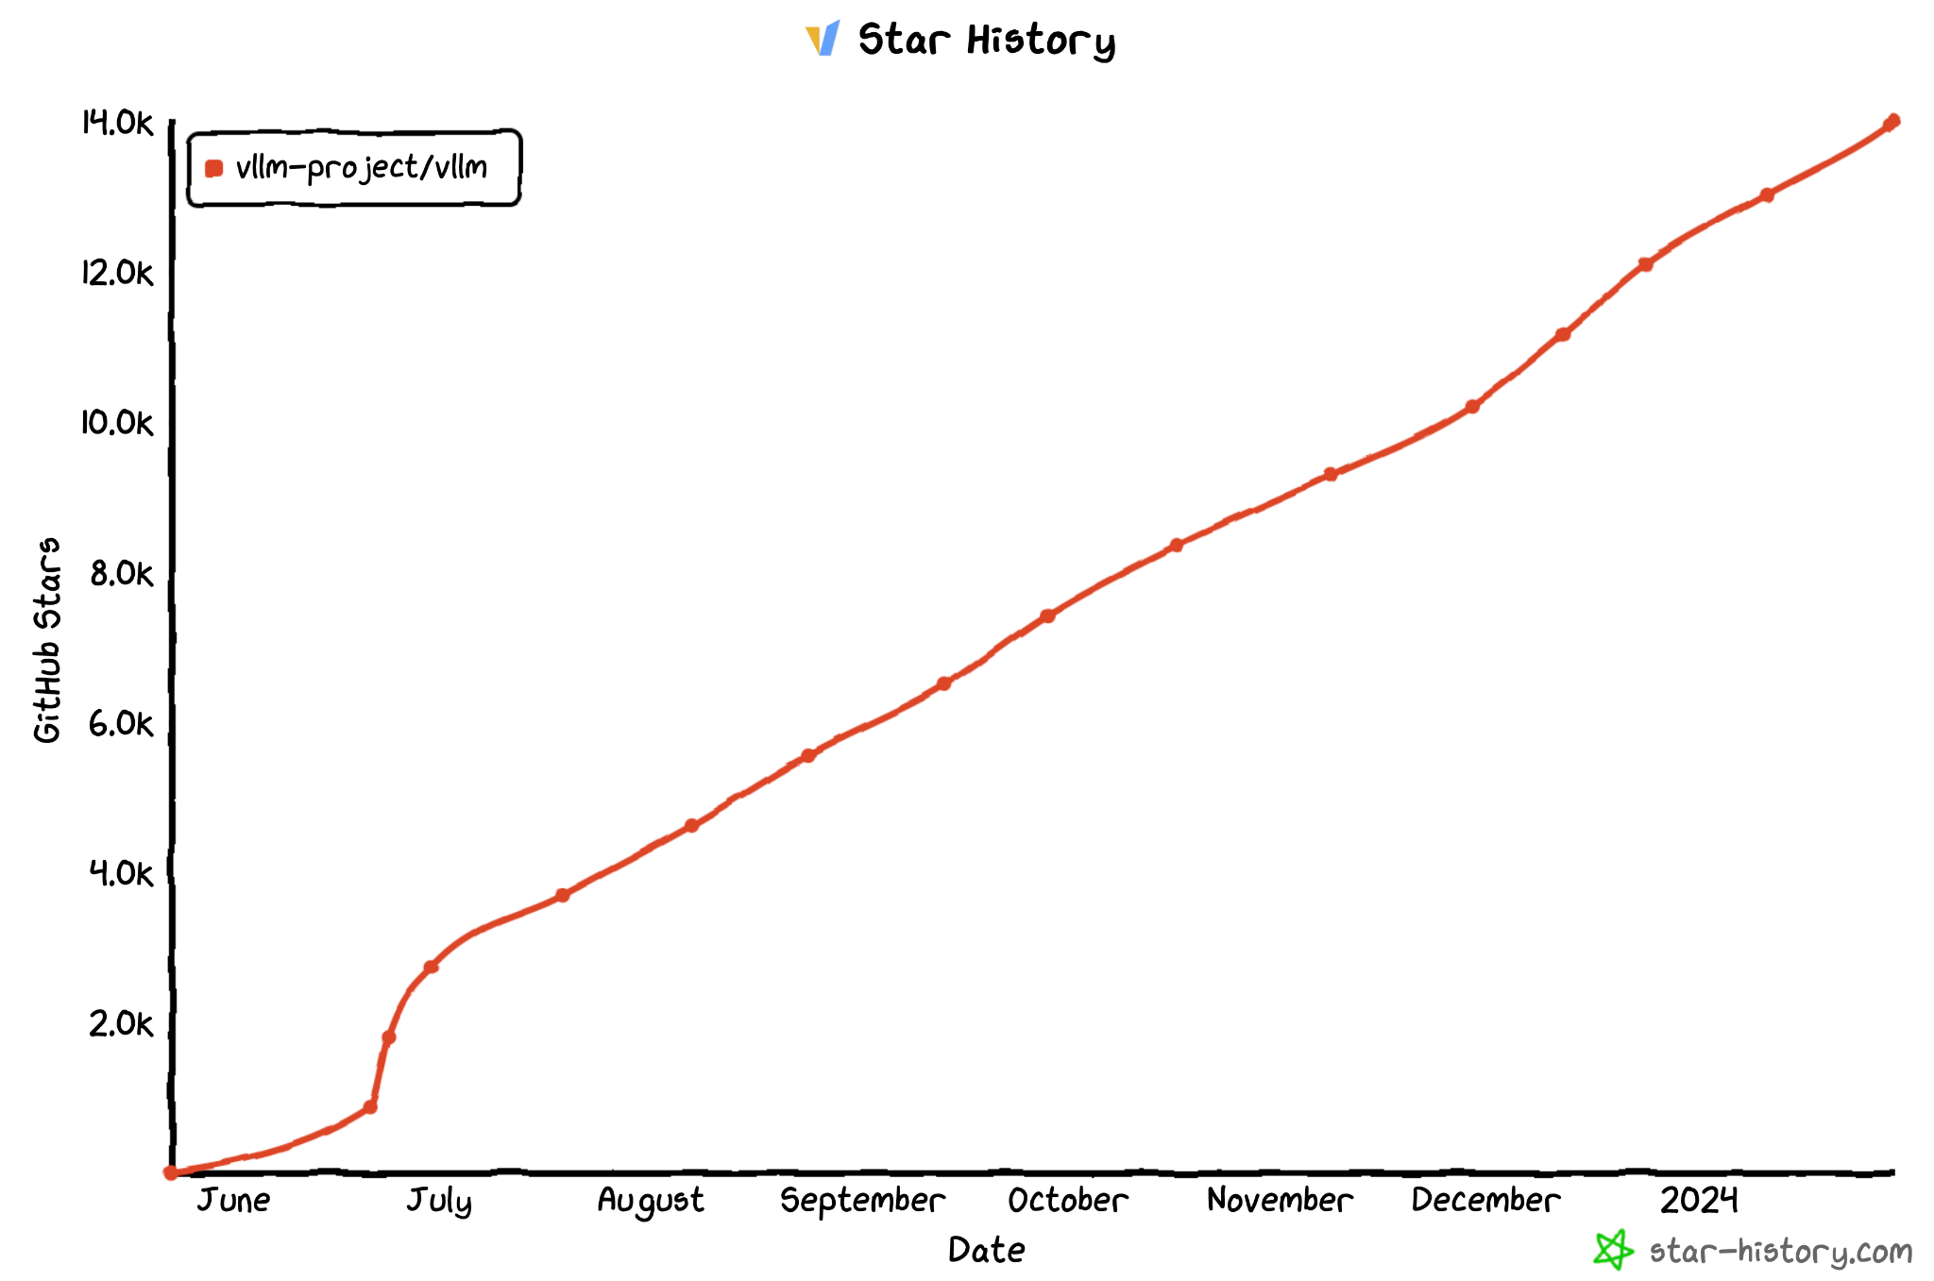
vLLM Github Repo
https://github.com/vllm-project/vllm
$ pip install vllm
14K Stars
Official
release!

Slide 10
vLLM API (1): LLM class
A Python interface for offline batched inference
from vllm import LLM
# Example prompts.
prompts = ["Hello, my name is", "The capital of France is"]
# Create an LLM with HF model name.
llm = LLM(model="meta-llama/Llama-2-7b-hf")
# Generate texts from the prompts.
outputs = llm.generate(prompts)

Slide 11
vLLM API (2): OpenAI-compatible server
A FastAPI-based server for online serving
Server
$ python -m vllm.entrypoints.openai.api_server --model meta-llama/Llama-2-7b-hf
Client
$ curl http://localhost:8000/v1/completions \
-H "Content-Type: application/json" \
-d '{
"model": "meta-llama/Llama-2-7b-hf",
"prompt": "San Francisco is a",
"max_tokens": 7,
"temperature": 0
}'

Slide 12

Contributors
Thanks to 190+ contributors who raised issues, participated in discussions, and submitted PRs!
…

Slide 13























vLLM Adopters
Open-Source Projects
Companies
lm-sys/FastChat
EleutherAI/lm- evaluation-harness
allenai/open-instruct
outlines-dev/outlines
…
…

Slide 14
Default LLM Serving Engine on Microsoft Azure
Our default choice for serving models is vLLM, which provides high throughput and efficient memory management with continuous batching and Paged Attention.
– Rashaud Savage, Microsoft Azure
Source: https://aka.ms/OpenModels

Slide 15
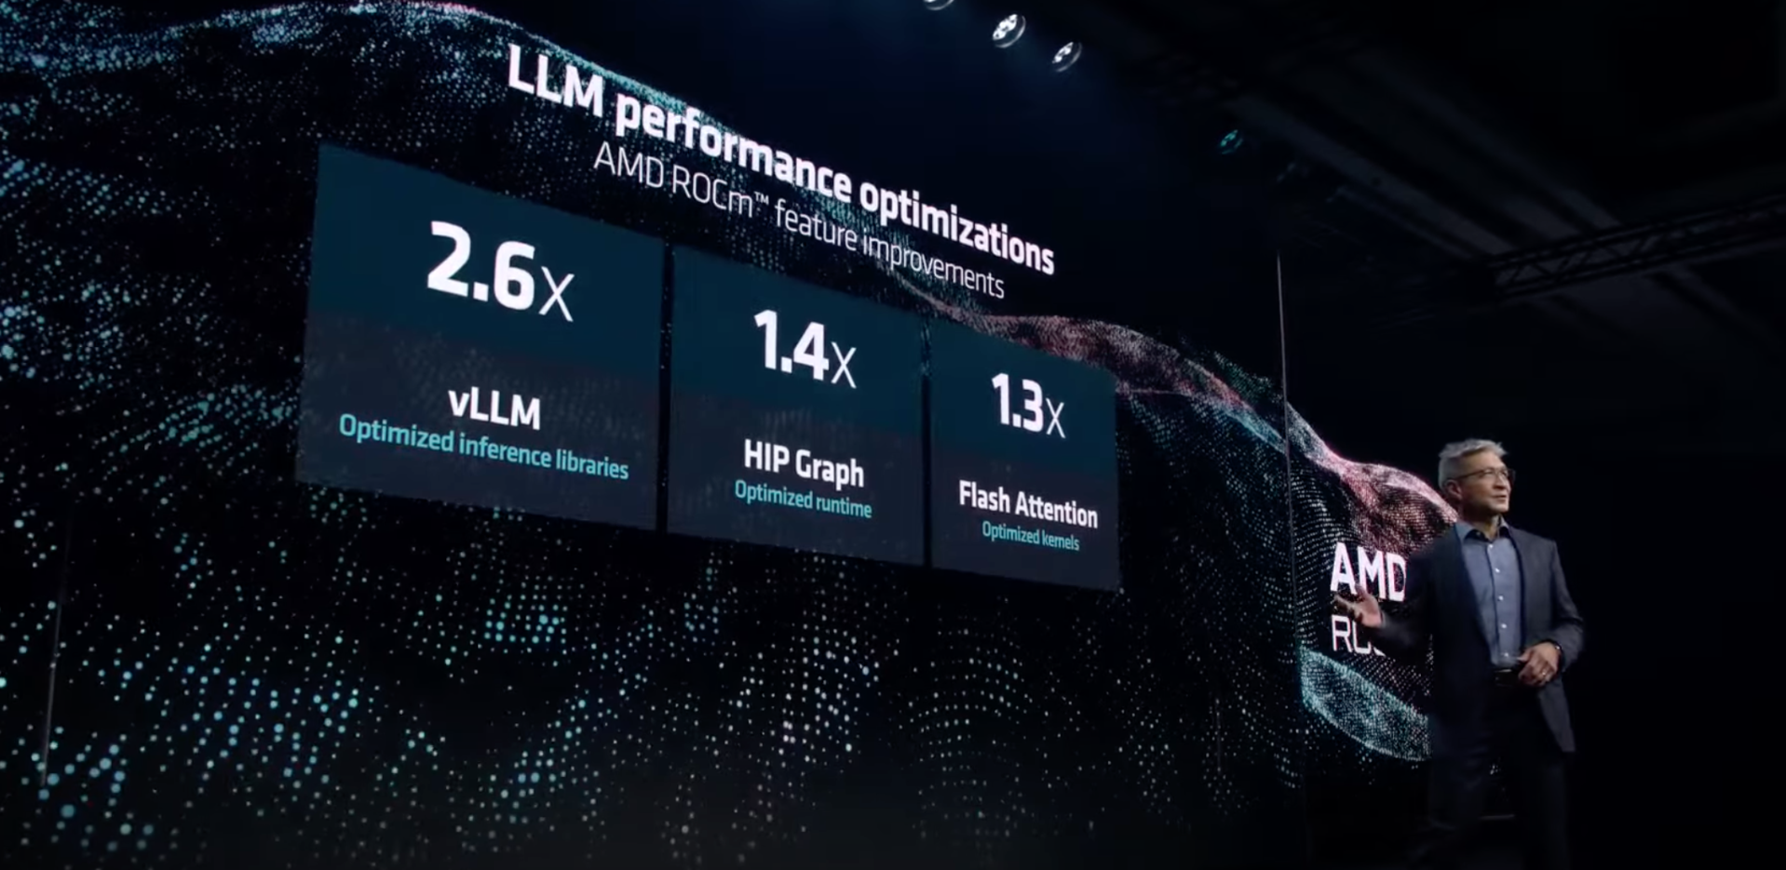
Featured at AMD MI300x Launching event
Source: AMD Presents: Advancing AI

Slide 16
Topics
vLLM Overview
Project Update
Development Roadmap

Slide 17
Updates since last meetup (Oct 2023)
New Model Support (e.g., Mixture-of-Experts)
Performance Optimization
PagedAttention V2
CUDA Graph
Distributed Runtime Optimization
Faster All Reduce Kernels
New Features
AMD GPU Support
Multi-LoRA Support
Quantization Support
Prefix Caching
CI/CD

Slide 18


Supported Models
Community support of 20+ different model architectures, covering most of the popular LLMs
E.g., Llama family, Mistral, Phi, MPT, Falcon, ChatGLM, …
Official support of Mixture-of-Expert model Mixtral from day 1
“To enable the community to run Mixtral with a fully open-source stack, we have submitted changes to the vLLM project” – Mixtral Announcement Blogpost
DeepSeek MoE is also supported
Optimized FusedMoE kernel improves performance.
(by @pcmoritz, @zwd003, @esmeetu and DeepSeek-AI)

Slide 19
Performance Optimization
PagedAttention V2
CUDA Graph
Distributed Runtime Optimization
Faster All-Reduce Kernels

Slide 20
PagedAttention V2 (by @WoosukKwon)
PagedAttention v1: 1 SM per sequence
PagedAttention v2: 1 SM per sequence partition
GPU
GPU
SM 0
SM 1
SM 0
SM 1
Q
Q
Q
Q
KV
KV
KV
KV
0 | 1 | 2 | 3 | 4 | 5 | 6
0 | 1 | 2 | 3
0 | 1
0 | 1
SM 2
SM 3
SM 2
SM 3
Q
Q
KV
KV
2 | 3
2 | 3
SM 4
SM 5
SM 4
SM 5
Q
Q
KV
KV
6
4 | 5
Kernel speedup: 3.7x on A100, 7.4x on H100 for long input
E2E speedup: 15% on H100 with LLaMA-13B

Slide 21

CUDA Graph (by @scv119 from Anyscale and @WoosukKwon)
Python/PyTorch overhead
CPU
torch.nn.Linear
torch.nn.GELU
torch.nn.Linear
GPU
matmul
kernel
gelu
kernel
matmul
kernel
Python/PyTorch overhead takes up to 50% of overall latency
Idle
Idle
Time
CPU
GPU
matmul
kernel
gelu
kernel
matmul
kernel
41% latency reduction with Phi-2 (2.7B) on A100 80G
Time

Slide 22
Distributed Runtime Optimization (by @zhuohan123)
Current architecture
New architecture
LLM Engine
(Ray driver process)
LLM Engine
(Ray driver process)
Python objects
(Serialization overhead)
Worker 0
(Driver proc)
Worker 0
(Ray actor)
Worker N
(Ray actor)
…
Input prep
Worker N
(Ray actor)
Input prep
Input prep
GPU tensors
(NCCL broadcast)
GPU tensor
GPU tensor
…
Model
Model
Model
Model
Sampler
Sampler
GPU tensors
(NCCL gather)
Sampler
Python objects
(Serialization overhead)
LLM Engine
(Ray driver process)
LLM Engine
(Ray driver process)
Up to 70% throughput increase with LLaMA-70B on 8x A100 80G

Slide 23
Faster All Reduce Kernels (by @hanzhi713)
Ring All Reduce
(NCCL)
One-shot All Reduce
(Ours)
GPU0
GPU1
GPU0
GPU1
GPU3
GPU2
GPU3
GPU2
Optimized for large tensors
Optimized for small tensors
Kernel speedup: Up to 2.6x on 8 A100 GPUs
E2E Speedup: Up to 20% on 8 A100 GPUs

Slide 24
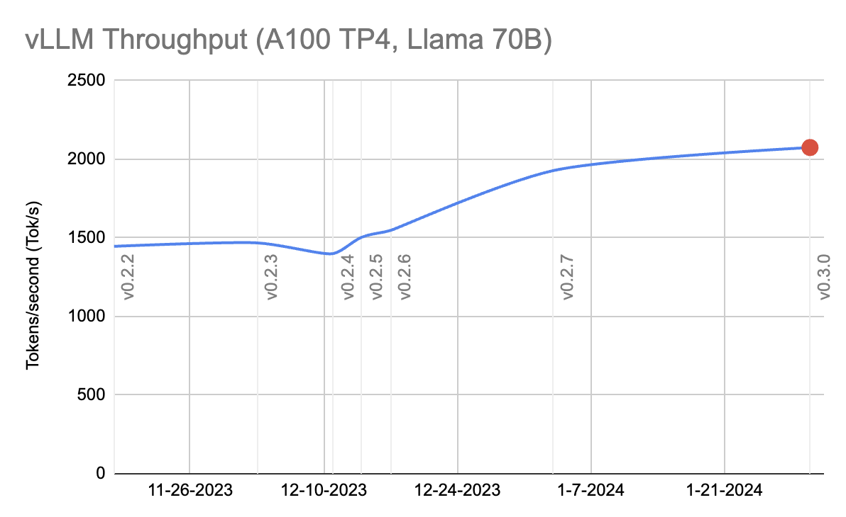
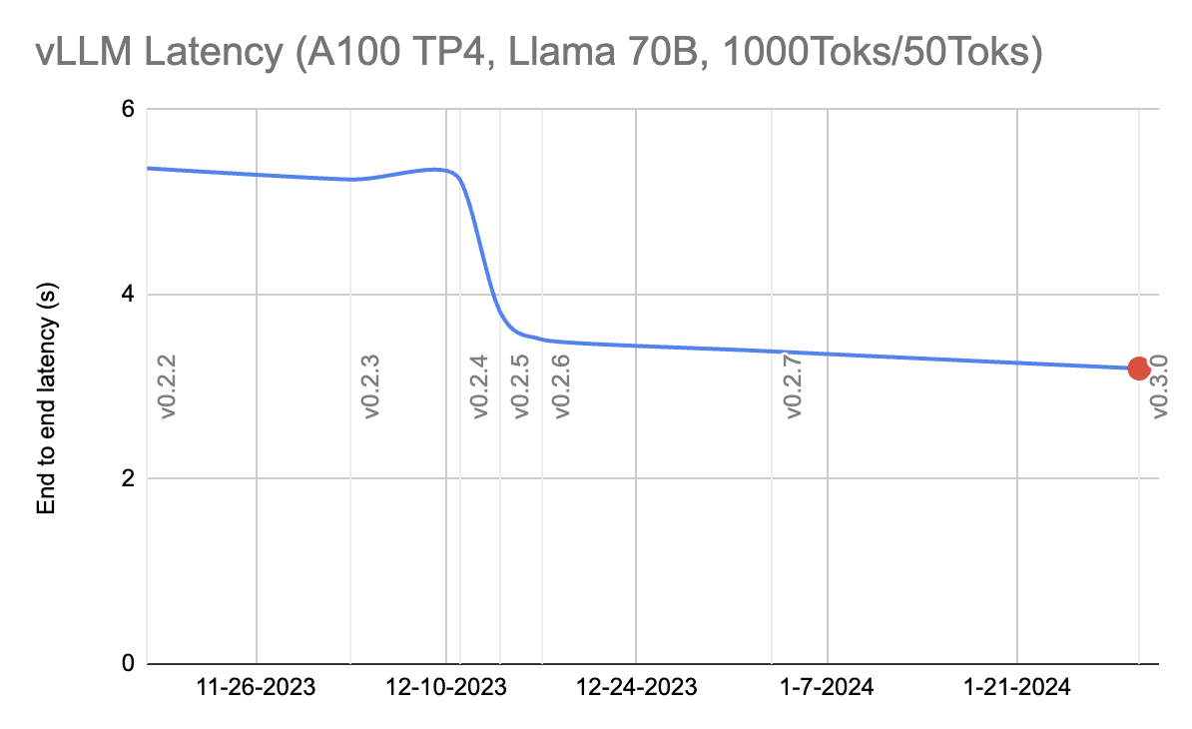
Result of Optimizations: Llama 70B
~50% Throughput improvement
~40% Latency reduction

Slide 25
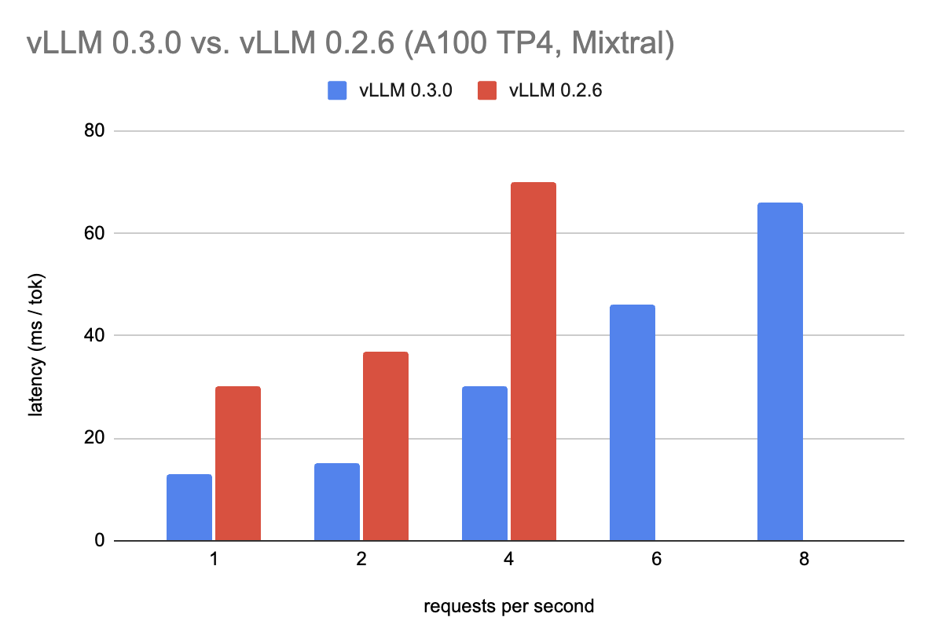
Result of Optimizations: Mixtral Model

Slide 26
New features
AMD GPU Support
Multi-LoRA Support
Quantization Support
Prefix Caching

Slide 27
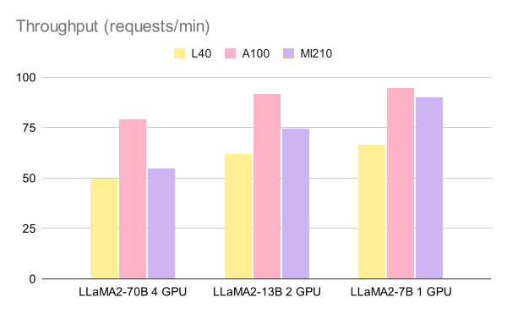

AMD GPU Support
Starting from December 2023, we have added AMD GPU support for all models in vLLM.
Contributed by @EmbeddedLLM and @AMD.
Next step is performance optimizations for MI300x.

Slide 28
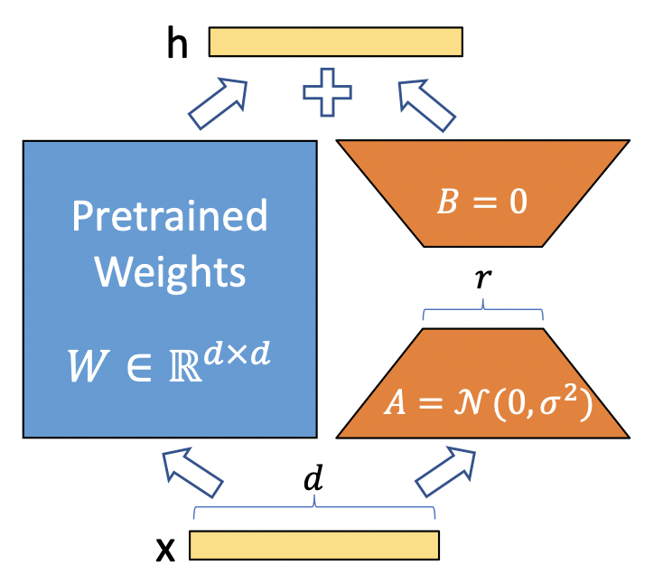
Multi-LoRA Serving (by @Yard1)
Multiple LoRA adaptors can be loaded to vLLM on the fly, and requests to different LoRAs can be batched together.
Contributed by Anyscale with the support from S-LoRA team, powered by Punica kernel.

Slide 29
Quantization Support
We have refactored vLLM (by @zhuohan123) to support quantization on all models with the following quantization methods:
GPTQ
By @chu-tianxiang from Alibaba, and enhancement to be merged by @JasonZhu1313 from LinkedIn
AWQ
By @ri938 from Chai Research, @casper-hansen from AutoAWQ, @julian-q from Stanford, and @WoosukKwon
SqueezeLLM
By @chooper1 from UC Berkeley (SqueezeLLM author)
FP8-E5M2 KV Cache
By @zhaoyang-star from ZTE

Slide 30
Prefix Caching (by @caoshiyi)
Common prefixes can be cached in vLLM’s paged memory. New requests can directly use the cached prefix without recomputation.
RFC: Automatic prefix caching (#2614).
Sequence A
Prompt
Sequence B
Prompt
A chat between a curious user and an artificial intelligence assistant. The assistant gives helpful, detailed, and polite answers to the user's questions.
A chat between a curious user and an artificial intelligence assistant. The assistant gives helpful, detailed, and polite answers to the user's questions.
Shared prefix
(fixed)
Input
User: Hello!
User: Who are you?
Sequence A
LLM output
Sequence B
LLM output
Output
Assistant: Hello! How are you?
Assistant: I am Vicuna.

Slide 31
Other Improvements
CI/CD (by @simon-mo)
Official pre-compiled binary and Docker Image
Batch completion OpenAI API
Countless bug fixes from the community

Slide 32
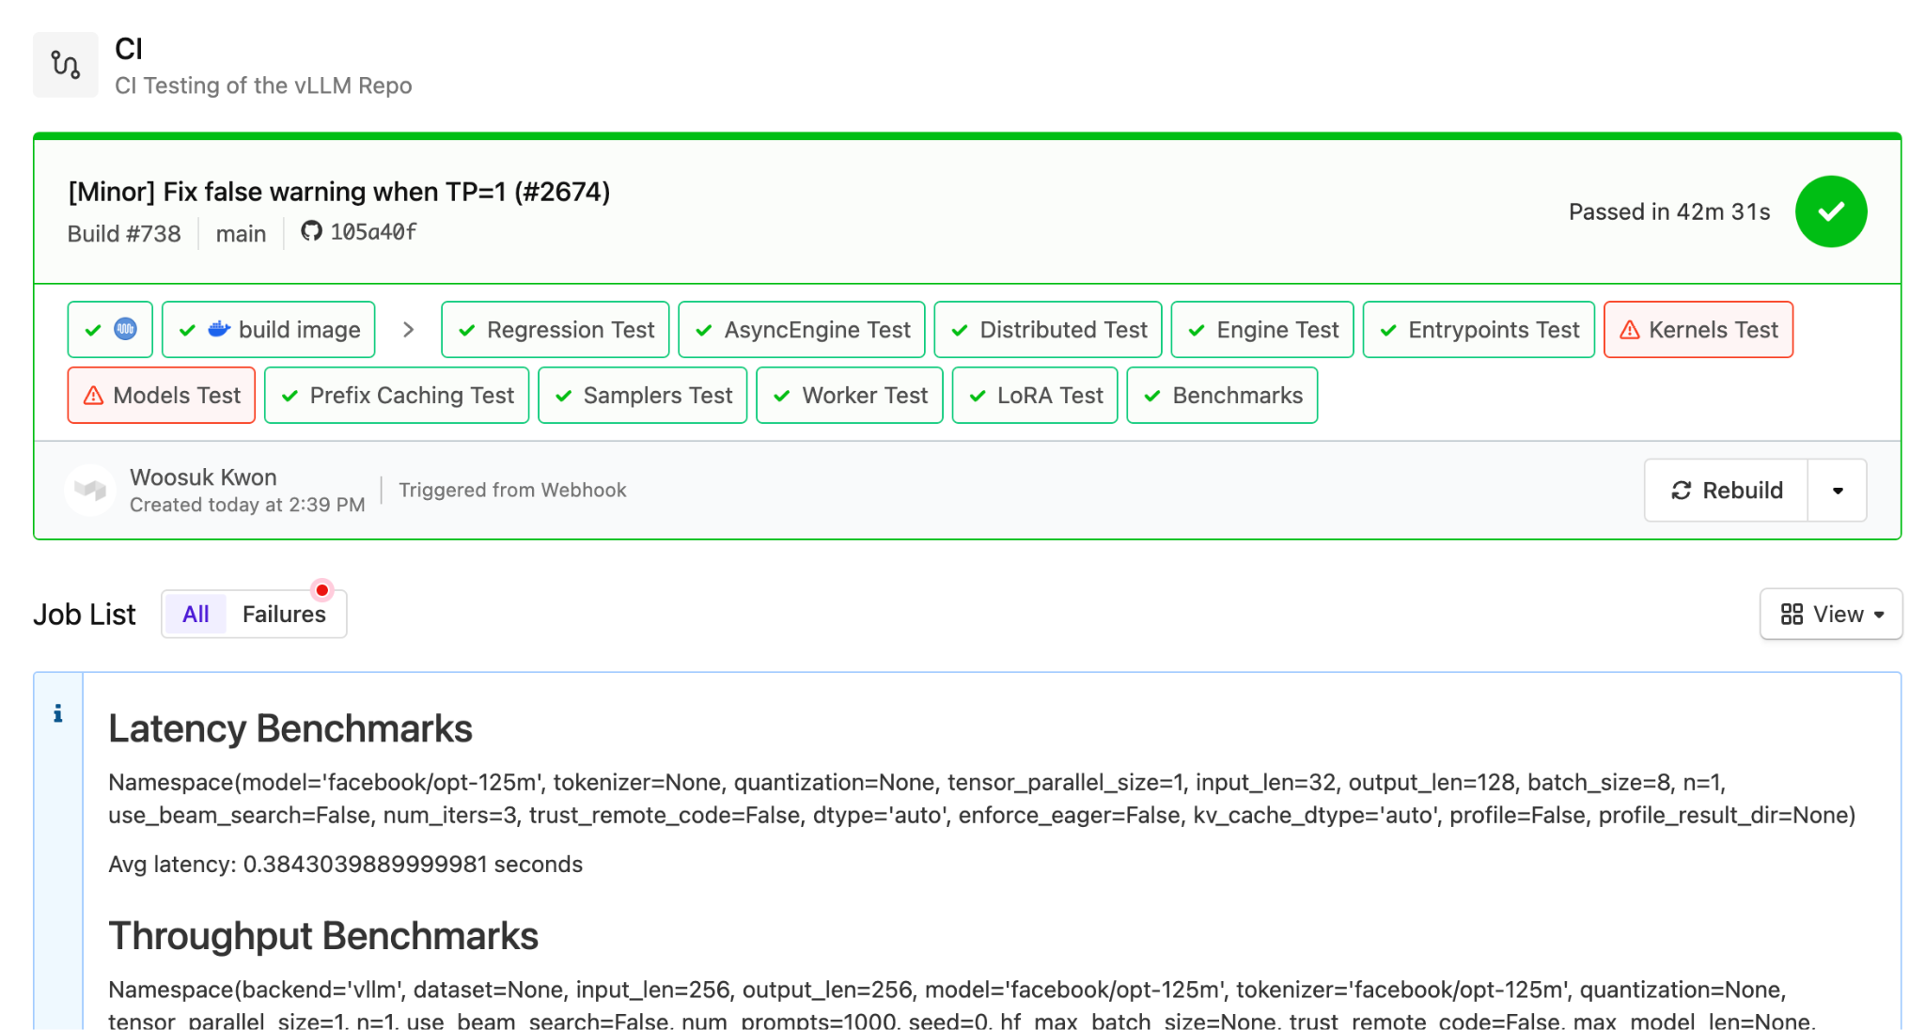
CI/CD (by @simon-mo)
Every PR is now tested and benchmarked on GPUs.

Slide 33
Topics
vLLM Overview
Project Update
Development Roadmap

Slide 34
Roadmap from 3 months ago
First-Priority Features
Second-Priority Features
Latency optimization
Lightweight runtime
Multi-process architecture
Speculative decoding
Better quantization support
CUDA-level optimization
(Efficient) LoRA support
AMD support
Mixture-of-experts
Pipeline parallelism

Slide 35
3 Months Ago -> Today
First-Priority Features
Second-Priority Features
✅ Latency optimization
✅ Lightweight runtime
🔨 Multi-process architecture
🔨 Speculative decoding
✅ Better quantization support
✅ CUDA-level optimizations
✅ (Efficient) LoRA support
✅ AMD support
✅ Mixture-of-experts
🔨 Pipeline parallelism
Distributed Runtime Optimization
Prefix Caching
CI/CD

Slide 36
Roadmap: Improvements
Performance optimizations: H100 and MoE
Scheduling optimizations: chunked prefill & prefill disaggregation
Support Activation Quantization
Extensible scheduler and memory manager
@torch.compile support

Slide 37
Roadmap: Features
Diverse hardware support
AWS Inferentia, Google TPU, Intel Gaudi, Intel GPU, Intel CPU
Multi-modal model support
Speculative decoding
Broad support for different algorithms
Automatic prefix caching (RFC Issue #2614)
Structured output (JSON, regex, grammar)

Slide 38
Speculative Decoding
In progress, joint effort from @cadedaniel, @ymwangg
Goal: have a general design to support different flavors of speculative decoding.
Use draft model: current focus.
Draft model free (e.g., Medusa, Eagle, BiTA, lookahead, ngram, retrieval-based).
Plan & Status: 2/9 (Reject sampling, MultiStepWorker).
Help needed: MQA kernel, efficient sampling kernel, Draft model free (tree verification).

Slide 39
Call for Contributors / Reviewers / Adopters
We are growing our reviewer and comitter base.
Please help us review PRs.
We are growing our comitter base as well, by demonstrating contributions over time.
Our roadmap comes from you, the vLLM community.
Don’t hesitate to reach out with your use case and feature requests.
We would love to learn more about how you are using vLLM.
Discuss more in the roadmap issue: #2681
vLLM is an open-source project, maintained by UC Berkeley, helped by organizations adopting vLLM.
We are not VC funded.
Can your organization help us in resources in any way? Talk to us!
Please email xmo@berkeley.edu, xiaoxuan_liu@berkeley.edu if you can help (hardware, cloud credits etc.)!!

Slide 40





Building the fastest and easiest-to-use open-source LLM inference & serving engine!
https://github.com/vllm-project/vllm
https://vllm.ai
https://arxiv.org/abs/2309.06180
https://discord.gg/jz7wjKhh6g

